Slide 1


Projection Visual Acuity Chart Calibration Settings
4th Semester M.C.A.
FINAL PROJECT PRESENTATION
By
Punith Bandodekar
(Registration Number: 140970027)
Under the guidance of
Mrs. Archana H. Dr. Ramesh S Ve
Assistant Professor-Senior scale Director
Department of Computer Applications Visint Healthcare Pvt. Ltd
M.I.T, Manipal - 576 104 Manipal - 576 104
Department of Computer Applications, MIT, Manipal

Slide 2
Presentation Outline
Introduction
Existing system
Proposed System
Objectives
Hardware Software Requirements
Modules
Diagrams
Implementation and testing
Screen Shots
Conclusion
Future Work
Bibliography
Department of Computer Applications, MIT, Manipal
1

Slide 3
1.Introduction
Projection visual acuity chart is an android application developed for vision testing using an android smartphone or a tablet and a portable projector
Different charts are displayed using the projector such as Snellen, LogMar, Landolt C, Tumbling E, Sloan
The vision testing is based on what characters the patients are able to see on the displayed chart
Department of Computer Applications, MIT, Manipal
2

Slide 4
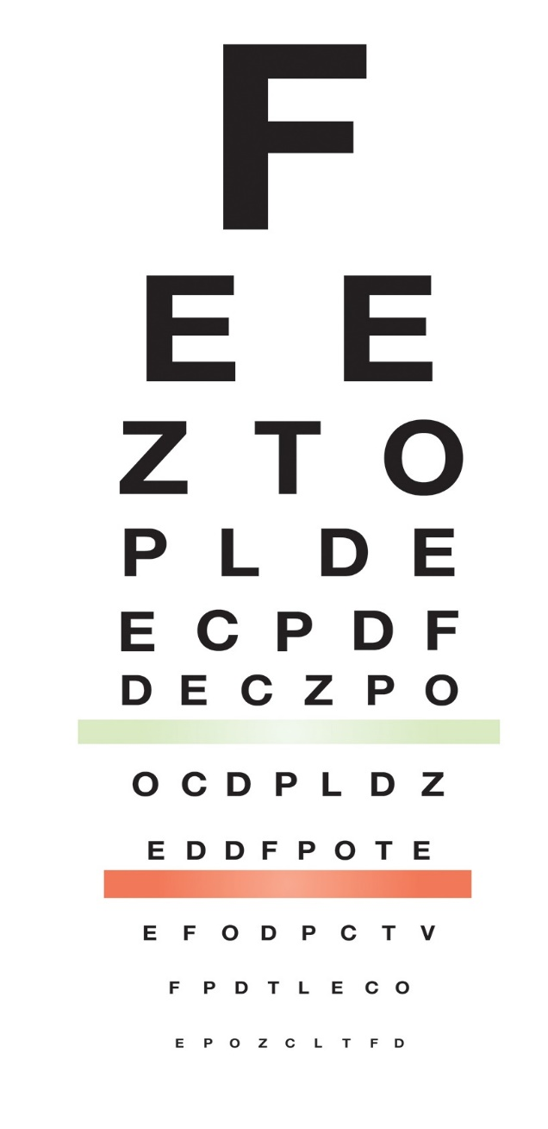
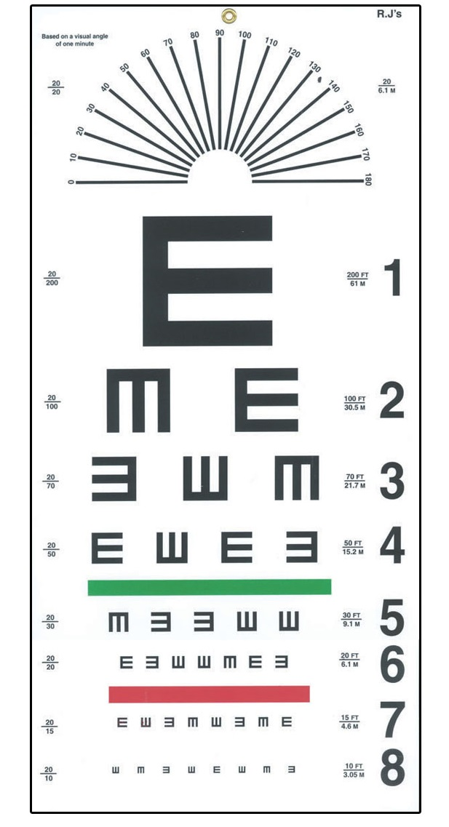
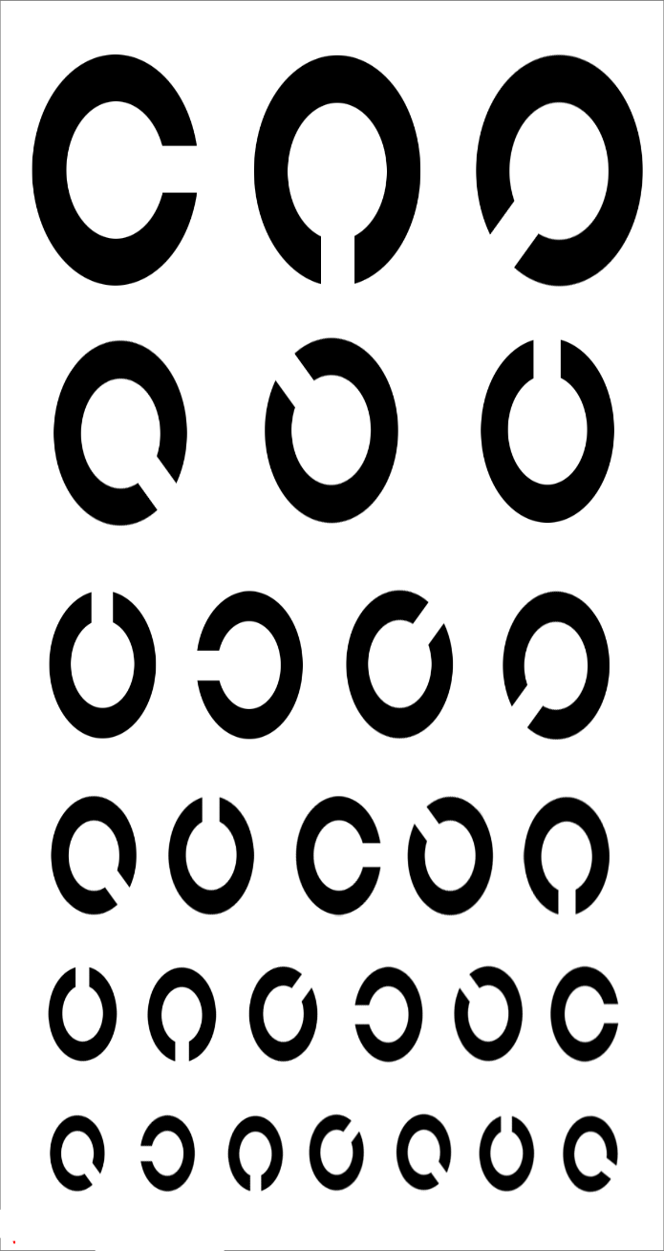
Charts
Figure 1: Snellen
Figure 2: Tumbling E
Figure 3: Landolt C
Department of Computer Applications, MIT, Manipal
3

Slide 5
2.Existing System
The current system is a computerized version of the eye diagnosis application for windows
It is less user friendly with poor UI design
It is not easily portable
Charts are displayed using a computer monitor
Department of Computer Applications, MIT, Manipal
4

Slide 6
3.Proposed System
An android application which performs vision testing using a smartphone and a mini projector
Designing graphically user friendly interface
Department of Computer Applications, MIT, Manipal
5

Slide 7
4.Objectives
To display the character with respect to the distance between the projector and the projected screen
To create simple and user friendly interface
To store different chart settings using shared preferences
Charts are visualized through a portable mini projector
To design various types of charts such as Snellens, LogMar, Landolt C and Sloan
Department of Computer Applications, MIT, Manipal
6

Slide 8
5.Requirements for development
HARDWARE REQUIREMENTS
Minimum of 2 GB RAM or above
400 MB hard disk space
Intel Pentium 3 processor or higher
SOFTWARE REQUIREMENTS
Microsoft Windows 8/7/Vista
At least 1 GB for Android SDK, emulator system images and caches
Java Development Kit (JDK) 7 or above
Department of Computer Applications, MIT, Manipal
7

Slide 9
Requirements for deployment
Android- 4.2.1 and above
Screen size for Android devices- 5’ and above
DLP3010 Light Crafter Mini Projector
Department of Computer Applications, MIT, Manipal
8

Slide 10
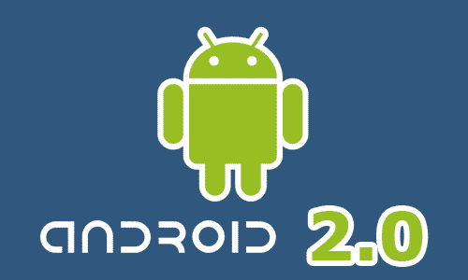


Technology Used
Front End- Android 2.0
Back End- SQLite 3.3
Department of Computer Applications, MIT, Manipal
9

Slide 11
6.Modules
Calibration Module: Here we adjust the height and width of the character displayed on the projected screen
Visualizing Charts: This module exhibits the selected chart for patient’s vision testing. The visualization displays different types of charts such as Snellens, Logmar, Landolt C and Sloan charts
Department of Computer Applications, MIT, Manipal
10

Slide 12
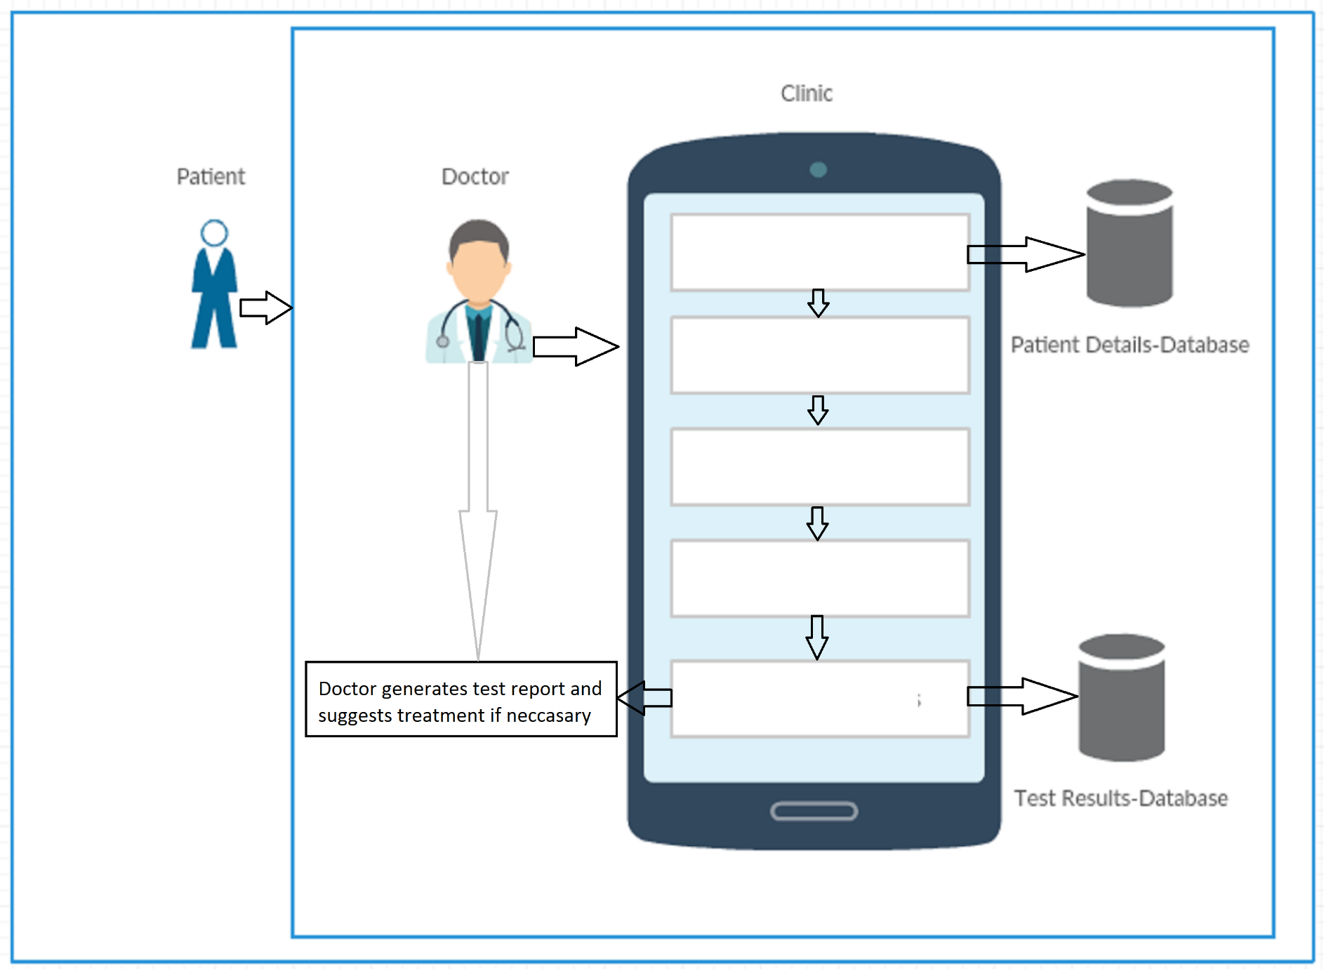
Block Diagram
Patient Details
Calibration
Chart Settings
Display Chart
Display Test Results
Figure 4: Block Diagram
Department of Computer Applications, MIT, Manipal
11

Slide 13
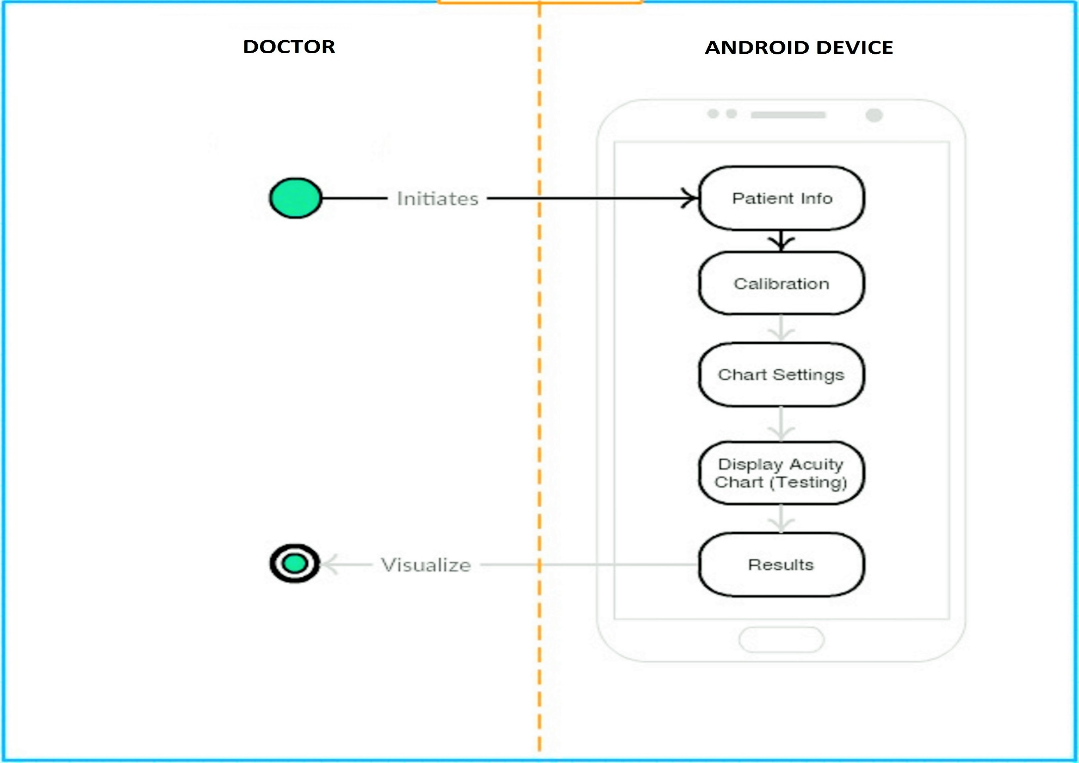
Activity Diagram
Figure 5: Activity Diagram
Department of Computer Applications, MIT, Manipal
10

Slide 14
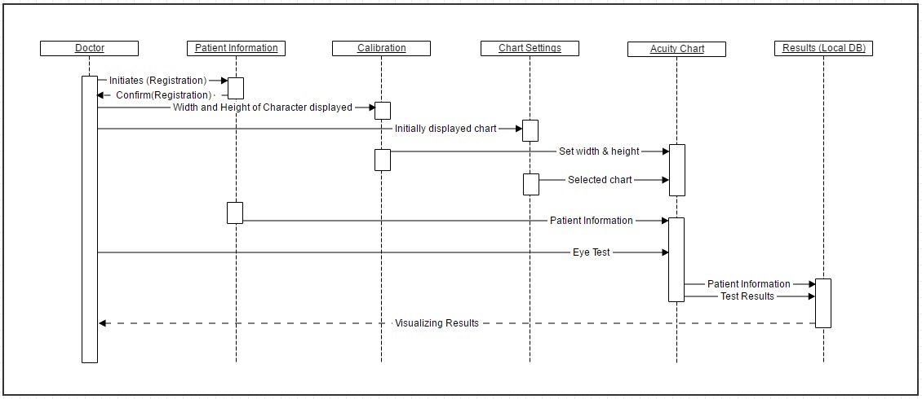
Sequence Diagram
Figure 6: Sequence Diagram

Slide 15
8.Implementation
Initial design based on the requirements
Dividing the work among the team members
Working with deadlines for a particular work
Sharing of knowledge on Android among team members
Implementation of material design for Android
Department of Computer Applications, MIT, Manipal
14

Slide 16
Testing
Unit Testing to check for validation and verification of the data entered
Integration testing in order to check for the correct working of modules after integration
Department of Computer Applications, MIT, Manipal
15

Slide 17
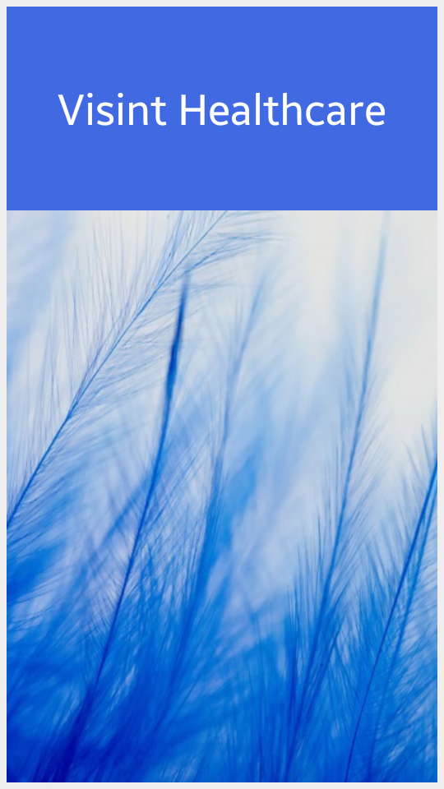
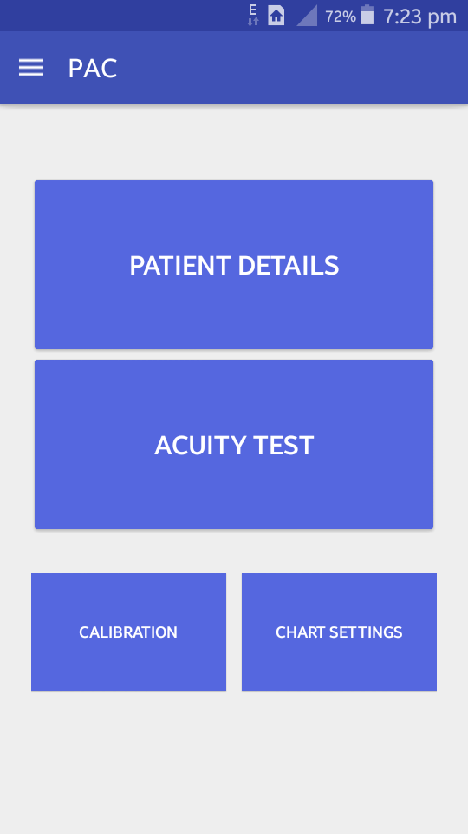
9.Screenshots
Figure 7: Splash Screen
Figure 8: Home Screen
Department of Computer Applications, MIT, Manipal
16

Slide 18
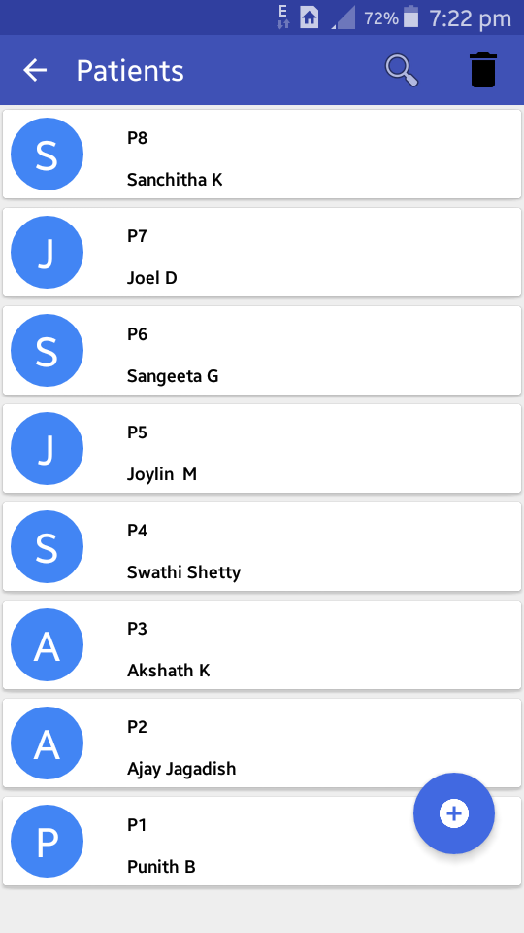
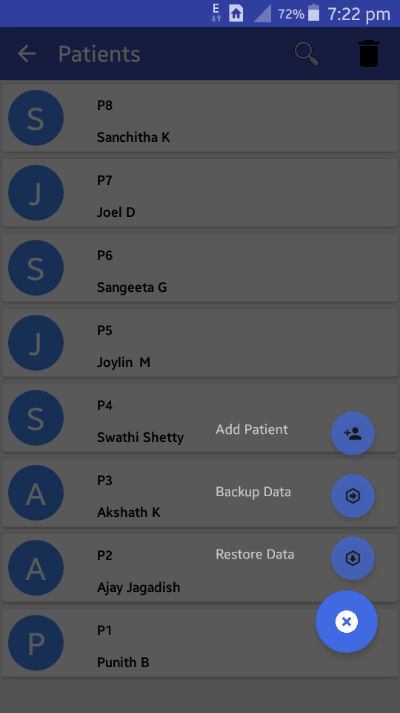
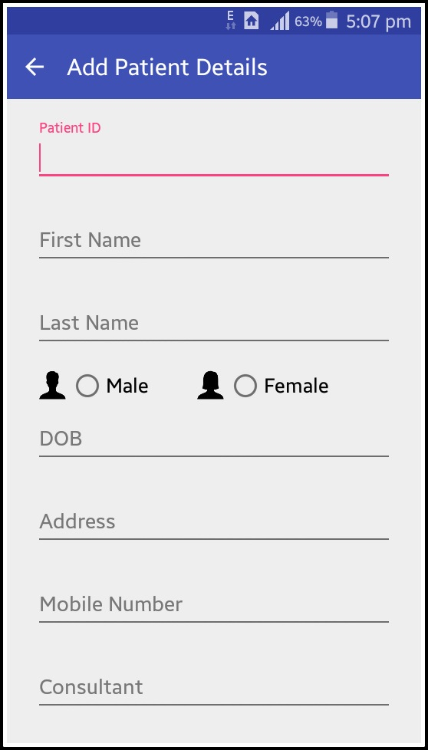
Screenshots
Figure 9: Patient List
Figure 10: Add Patient Details
Department of Computer Applications, MIT, Manipal
17

Slide 19
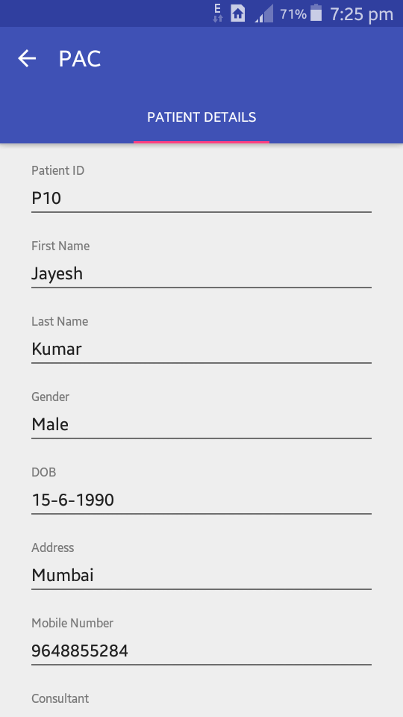
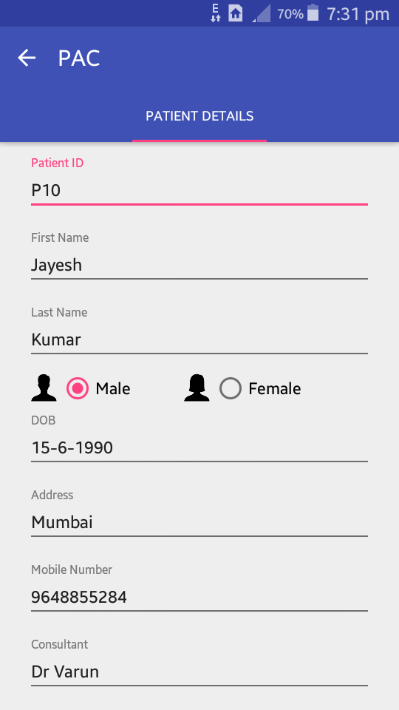
Screenshots
Figure 11: Edit Patient Details
Department of Computer Applications, MIT, Manipal
18

Slide 20
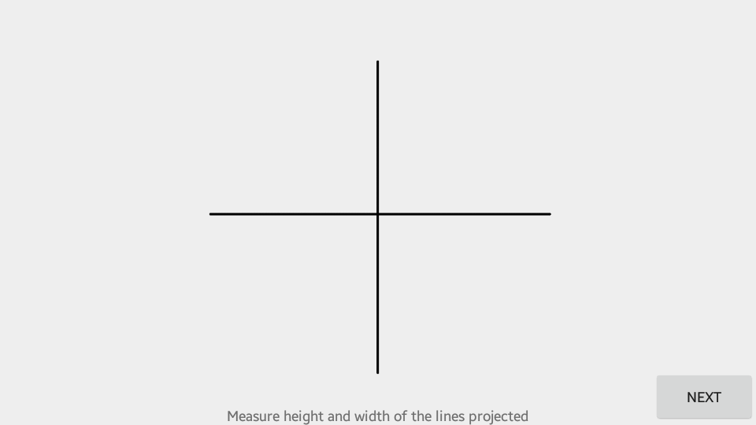
Screenshots
Figure 12: Calibration
Department of Computer Applications, MIT, Manipal
19

Slide 21
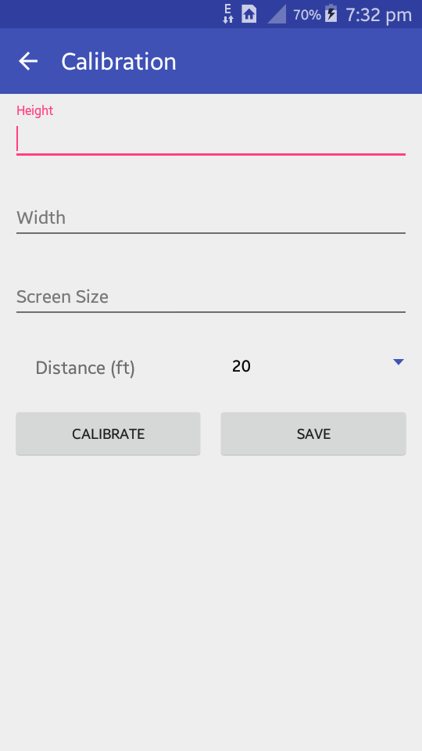
Screenshots
Figure 13: Calibration
Department of Computer Applications, MIT, Manipal
20

Slide 22
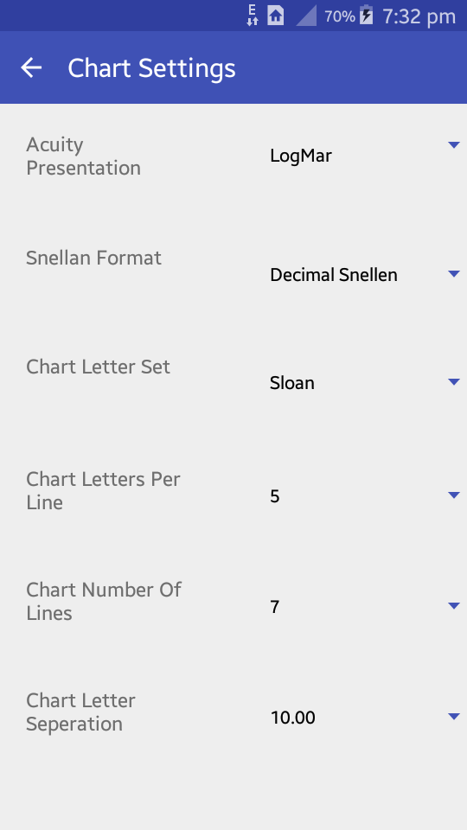
Screenshots
Figure 14: Chart Settings
Department of Computer Applications, MIT, Manipal
21

Slide 23
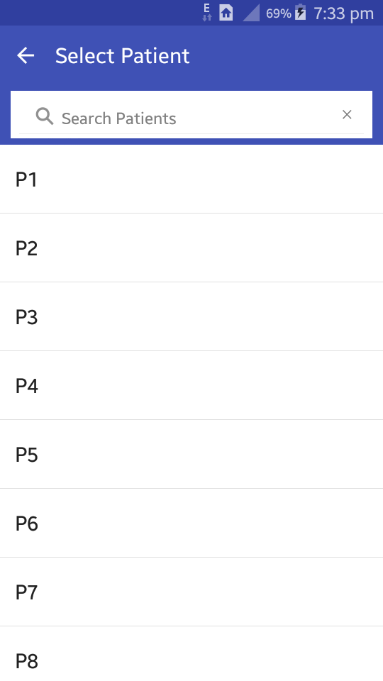
Screenshots
Figure 15: Select Patient
Department of Computer Applications, MIT, Manipal
22

Slide 24
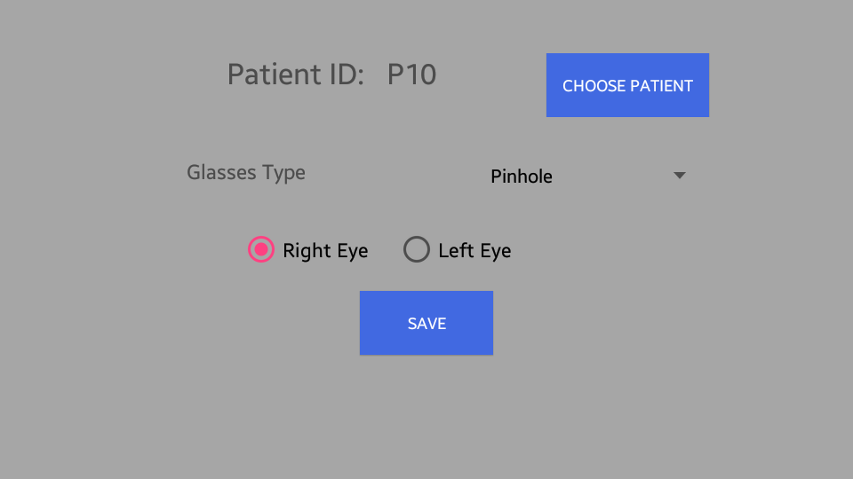
Screenshots
Figure 16: Test Settings
Department of Computer Applications, MIT, Manipal
23

Slide 25
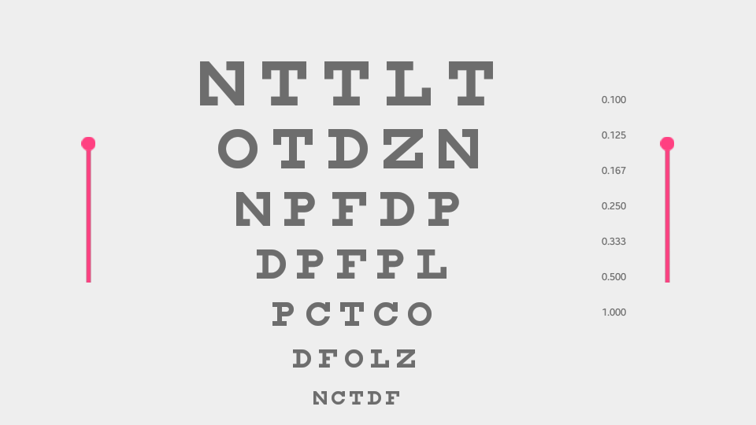
Screenshots
Figure 17: Acuity Chart
Department of Computer Applications, MIT, Manipal
24

Slide 26
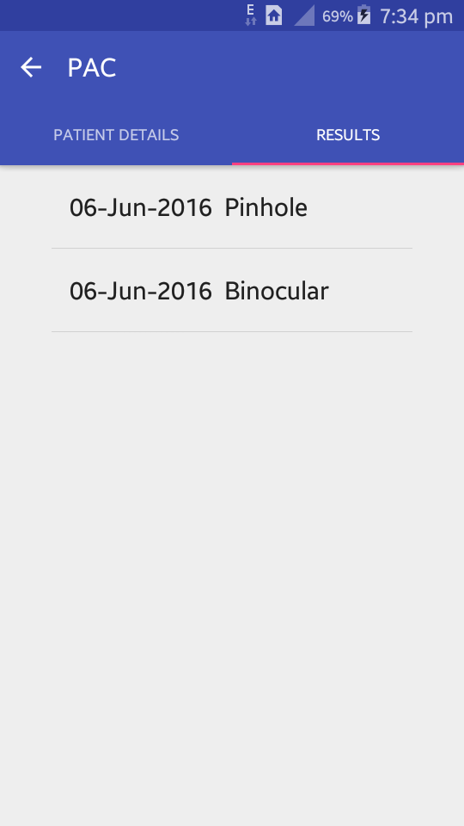
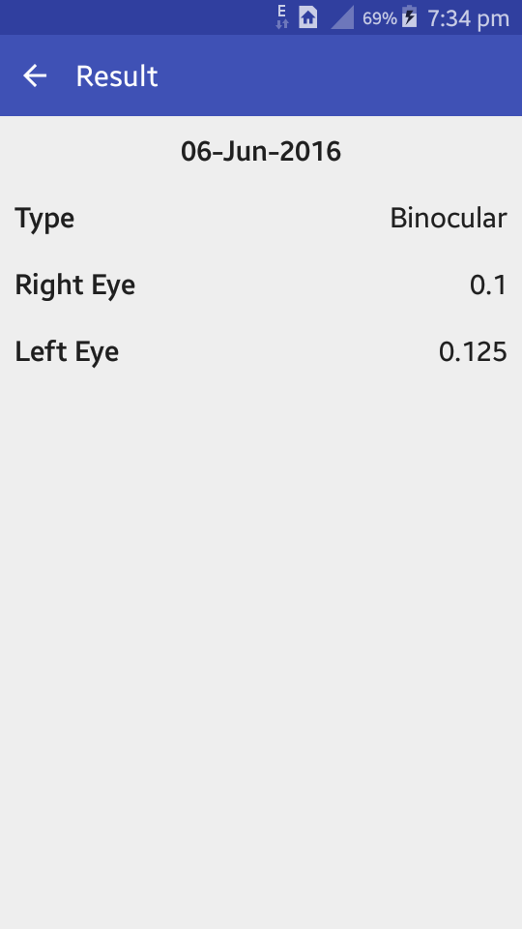
Screenshots
Figure 18: Results
Department of Computer Applications, MIT, Manipal
25

Slide 27
KEY MILESTONES
Internship from 28-January-2016 to 28-May-2016
MILESTONE | DEADLINE | COMMENTS
Project Started | 28-January-2016 | Learning Android Concepts, Installing Android Studio, Working on Examples
Synopsis | 20-Febraury-2016 | Synopsis Submission
Finalized Interface Design | 15-March-2016 | Designs had to be done a week in advance of abstract for revisions
SRS document | 14-April-2016 | Abstract done by April 10th so a presentation can be created
Interface Implementation | 25-May-2016 | This had to be completed two weeks in advance of complete project so app can be thoroughly tested and bugs fixed
Final Report & Presentation | 10-June-2016 | Completion of project
Department of Computer Applications, MIT, Manipal
22

Slide 28
10.Conclusion
The project “Projection Visual Acuity Chart” is implemented with the objective to make use of a mobile device for vision testing instead of a computer
Improved my knowledge on how a vision testing is performed
Learnt how to display characters with different sizes on an android platform
Understood the working of portable mini projector
Department of Computer Applications, MIT, Manipal
27

Slide 29
11.Future Work
This application can be customized to make it more user friendly
This application can be developed further by adding vision testing using Letter Contrast Sensitivity, Refraction/Sight Testing, Stereo Acuity modules
Department of Computer Applications, MIT, Manipal
28

Slide 30
Bibliography
M. Ettore Giardini, "The Portable Eye Examination Kit : Mobile phones can screen for eye disease in low resource settings.", IEEE Pulse, vol. 6, no. 6,pp.15-17, 2015.
Bailey, Ian L. and Lovie-Kitchin, "Jan E.Testing Vision : From Laboratory Psychophysical Tests to Clinical Evaluation", Vision Research, Elsevier, IEEE Pulse, vol. 3, no. 4, pp.17-20, 2013.
www.tutorialspoint.com/android [Last visited 13/03/2016]
www.developer.android.com [Last visited 29/03/2016]
www.stackoverflow.com [Last visited 02/04/2016]
www.androidhive.com [Last visited 27/03/2016]
Department of Computer Applications, MIT, Manipal
29

Slide 31
THANK YOU
Department of Computer Applications, MIT, Manipal
30

